Slide 1

Makefiles
CSC 1300

Slide 2
What is a Makefile?
Manually compiling and linking a program with numerous source and header files can be time consuming and challenging.
A Makefile is a special file used by the make utility to automate the process of compiling and linking programs.
The make utility uses a Makefile to recompile and link a program whenever changes are made to the source or header files.

Slide 3
Purpose and Benefits of using a Makefile
Saves time by automating builds with a single command (make).
Helps manage multiple files and their dependencies.
Only recompiles the files that actually changed.
Keeps your project organized and easier to maintain.
Consistently compiles the project the same way every time.
Makefiles are portable! You can use the same Makefile across different systems.

Slide 4
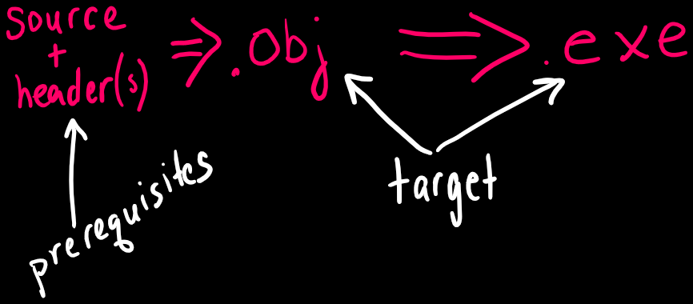
Makefile Rules and Commands
The Makefile contains make rules to specify dependencies between an object file and executable file and a set of prerequisite files (source & header files) that are needed to generate the object file.

Slide 5
Makefile Rule Syntax
Example Rule
target: prerequisite_1 prerequisite_2… prerequisite_n
command_1
command_2

Slide 6
Makefile Example
Suppose your project includes the following files:
turtle.h – contains your header file for your program
driver.cpp – contains the main function
functions.cpp – contains all your programmer-defined functions
To create a Makefile to help you compile & run your program, you would create a text file named “Makefile” with NO extension and place it in the same directory as your source and header files.
The following slides shows how to create a Makefile for Windows and then how to create a Makefile for Mac. They are very similar.

Slide 7

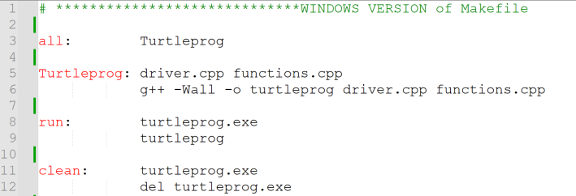

Makefile Example for Windows

Slide 8

Makefile Example for Windows
all is the default rule and the first one in the Makefile. It's the entry point for the build process. When you type “make” with no arguments in the command prompt, this is the rule that executes.
This rule requires the Turtleprog rule to execute (next slide)

Slide 9
Makefile Example for Windows
The Turtleprog rule executes only if driver.cpp and functions.cpp already exists.
This rule will compile the source files into an executable file named turtleprog.exe

Slide 10

Makefile Example for Windows
Type “make run” (without the double quotes) in the command prompt to RUN your program.
This rule will only execute if the turtleprog.exe file exists.

Slide 11



Makefile Example for Windows
Type “make clean” (without the double quotes) in the command prompt to delete your executable file (turtleprog.exe).
This rule will only execute if the turtleprog.exe file exists.

Slide 12
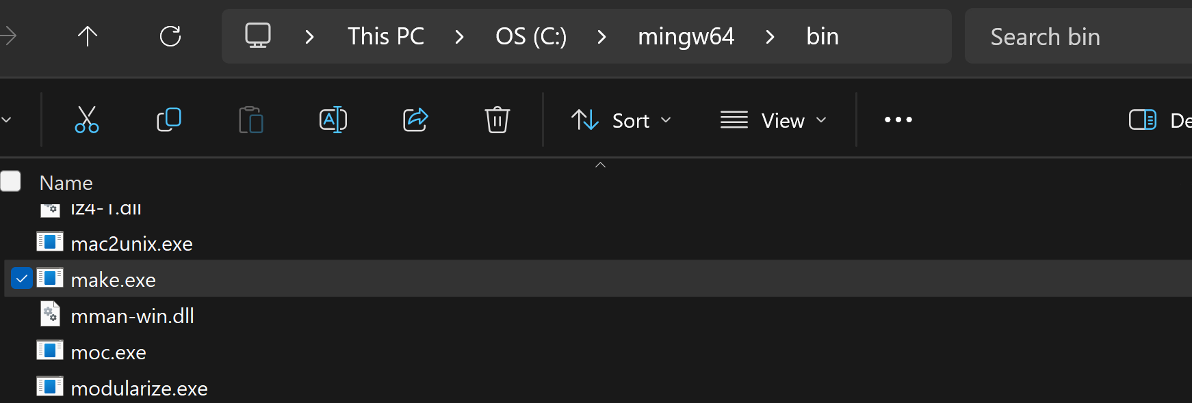
Using Makefile on Windows (slide 1 of 4)
If you installed the MinGW compiler, it already came with make in the bin directory but it probably needs to be renamed.
Go to wherever you installed your mingw64 folder (mine is in C: drive)
Then click on the bin folder.
The files are in alphabetical order. Scroll way down to the m’s.
Rename mingw32-make to just make

Slide 13
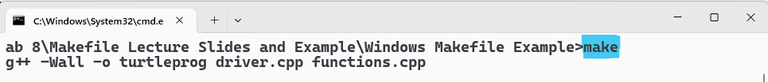
Using Makefile on Windows (slide 2 of 4)
Now go to the directory where your program (and Makefile) are located in your command prompt or terminal and type make. This creates your executable file.

Slide 14
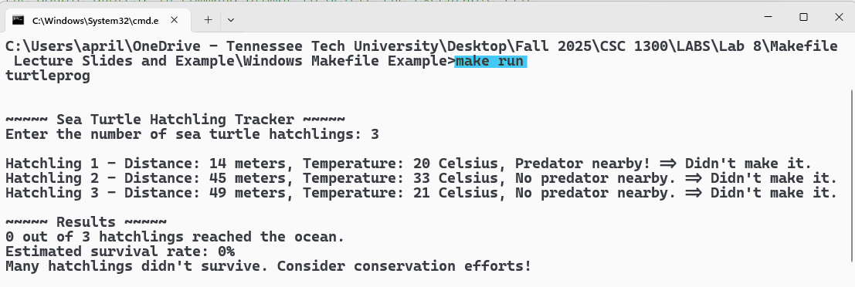
Using Makefile on Windows (slide 3 of 4)
Now run your program by typing make run in your command prompt.

Slide 15
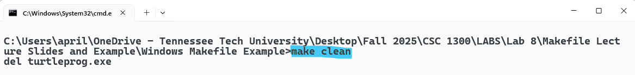
Using Makefile on Windows (slide 4 of 4)
If you want to delete your executable file, type make clean in your command prompt.

Slide 16
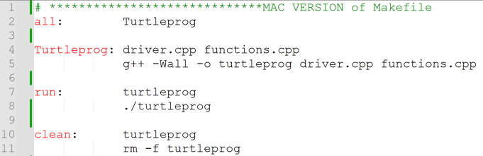
Makefile Example for Mac

Slide 17
Makefile Example for Mac
all is the default rule and the first one in the Makefile. It's the entry point for the build process. When you type “make” with no arguments in the terminal, this is the rule that executes.
This rule requires the Turtleprog rule to execute (next slide)

Slide 18
Makefile Example for Mac
The Turtleprog rule executes only if driver.cpp and functions.cpp already exists.
This rule will compile the source files into an executable file named turtleprog

Slide 19

Makefile Example for Mac
Type “make run” (without the double quotes) in the terminal to RUN your program.
This rule will only execute if the turtleprog executable file exists.

Slide 20



Makefile Example for Mac
Type “make clean” (without the double quotes) in the terminal to delete your executable file (turtleprog).
This rule will only execute if the turtleprog executable file exists.

Slide 21
Using Makefile on Mac
Xcode already comes with make. To verify in your terminal, type
make –version
Then, you can duplicate the directions for Windows by typing make to create your executable and then run the program as usual.

Slide 22
Using Makefile on Linux
Ensure build-essential is installed. To verify in your terminal type
sudo apt update
sudo apt install build-essential
To verify make is installed in your terminal, type
make –version
Then, you can duplicate the directions for Windows by typing make to create your executable and then run the program as usual.

Slide 23


